Slide 1
FOOD RECOMMENDER SYSTEM Date : June 3, 2021
By
SreeHarika.M
Nikitha.K

Slide 2
CONTENTS
Abstract
Architecture
Technical details
Challenges
Output
References

Slide 3
ABSTRACT
Food Recommender System is an end user application which recommends the food items for an individual users on the basis of their interests . It also allow the users to rate the recipe. This application provides the platform to help an individual to find their favourite food. The purpose of this project was to develop an application using the popular recommendation approach such as collaborative filtering approach for recommending the recipes.

Slide 4
ARCHITECTURE
Signup and login pages creation
Create tables and insert data into them
Connect the flask to the database
Fire base authentication
Recommend the items for logged in users
Save rating

Slide 5
TECHNICAL DETAILS

Slide 6
Technology Stack
Angular
Python
Postgresql
IDEs
Visual studio code
Pycharm

Slide 7
Packages/Tools used
Flask
Psycopg2
PgAdmin4

Slide 8
Challenges
Connecting front end and back end
Authenticating the users
Recommending recipes to the registered users on the basis of their interest

Slide 9
OUTPUT

Slide 10
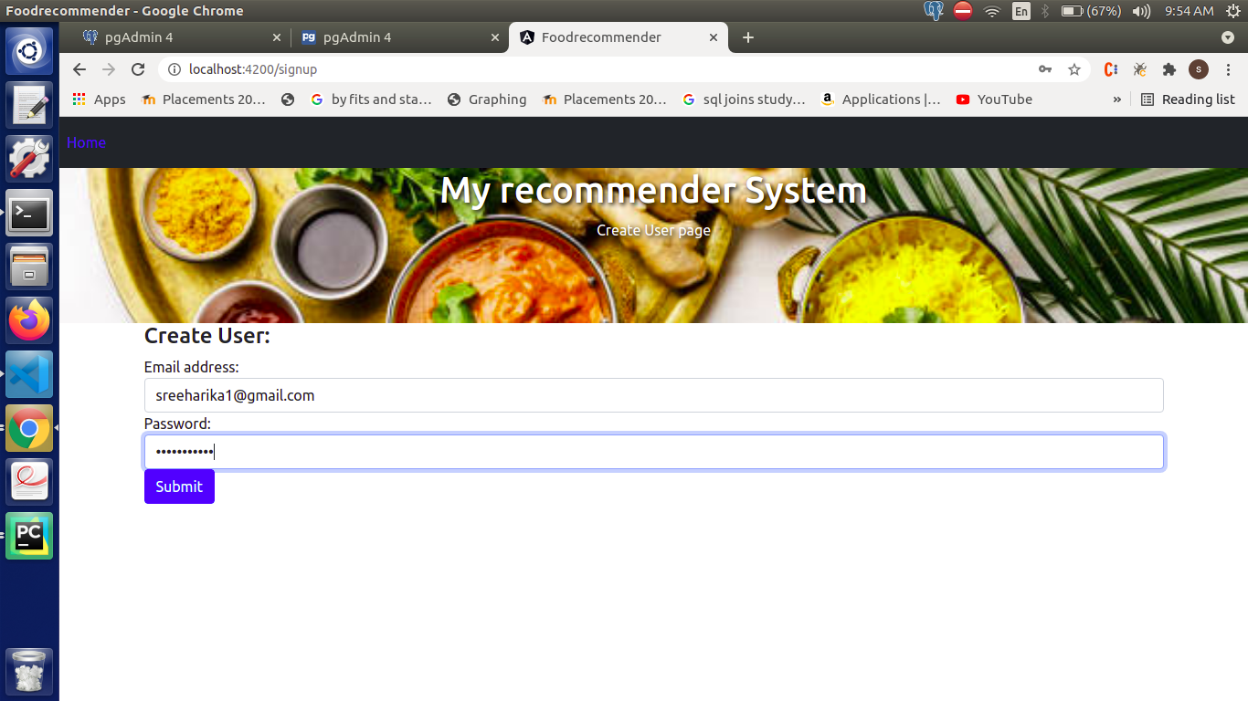
SignUp Page

Slide 11
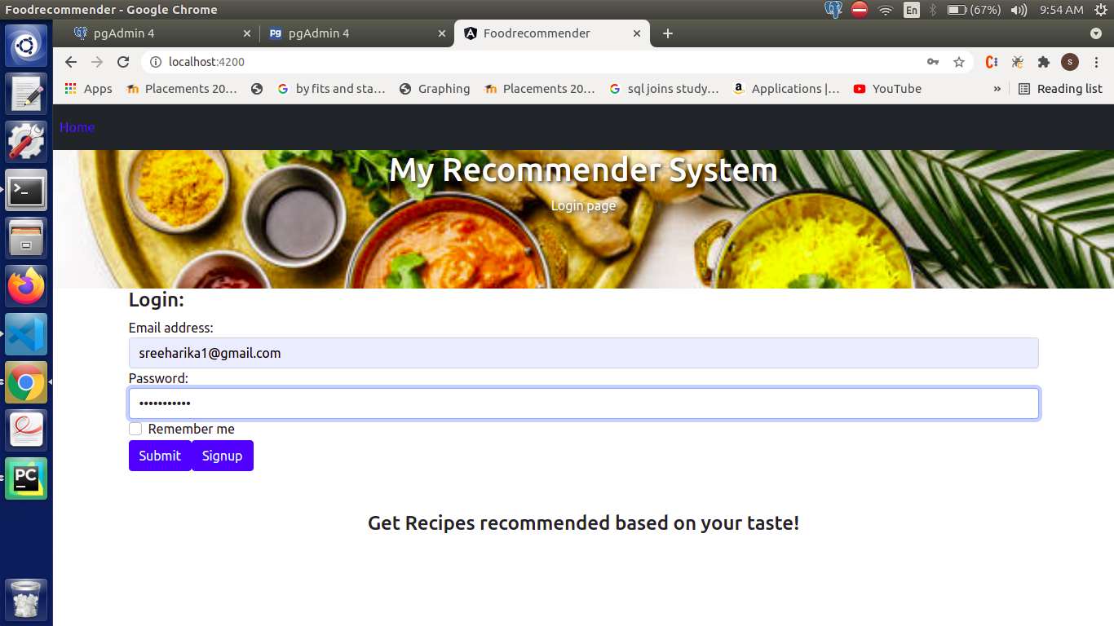
Login Page

Slide 12
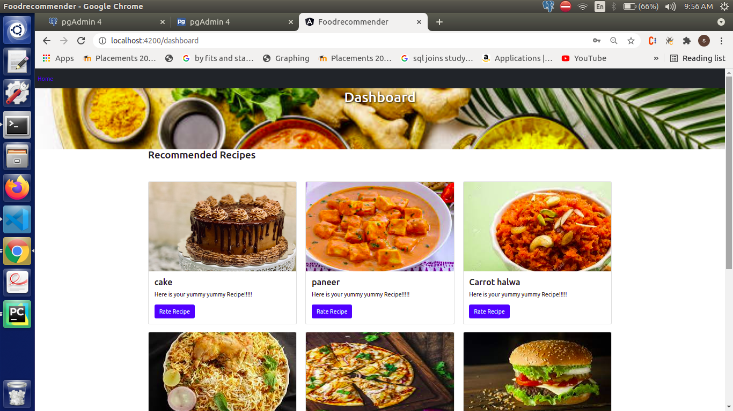
Recommended Recipes

Slide 13
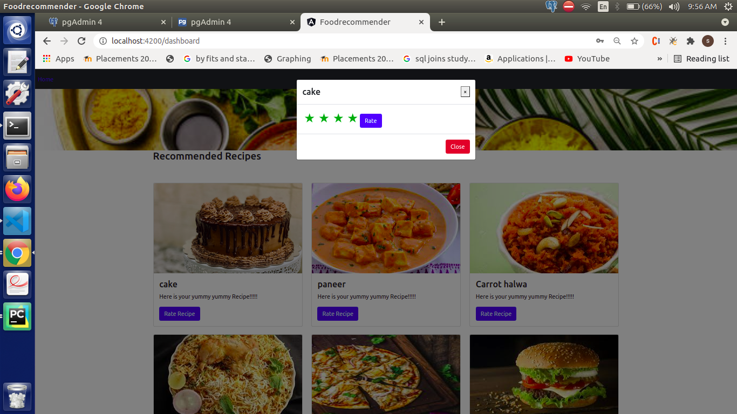
Rate Recipe

Slide 14
REFERENCES
https://www.w3schools.com/bootstrap/
https://www.fullstackpython.com/blog/postgresql-python-3-psycopg2-ubuntu-1604.html
https://linuxhint.com/install-pgadmin4-ubuntu/
https://www.positronx.io/angular-7-firebase-5-crud-operations-with-reactive-forms/

